Slide 1
Microprocessors and Assembly Language Lecture 11 Hamed Farbeh farbeh@aut.ac.ir Spring 2023

Slide 2
Copyright Notice
Parts (text & figures) of this lecture are adopted from:
Prabal Dutta, “EECS 373 Design of Microprocessor-Based Systems,” University of Michigan
Atmel | SMART ARM-based MCU DATASHEET, SAM3X / SAM3A Series, Atmel-11057C-ATARM-SAM3X-SAM3A-Datasheet_23-Mar-15

Slide 3

Sampling, ADCs, and DACs

Slide 4
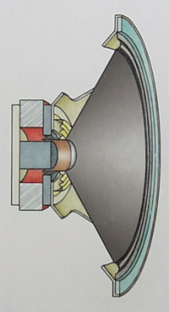
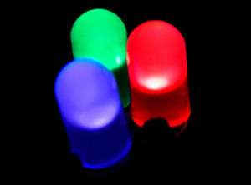
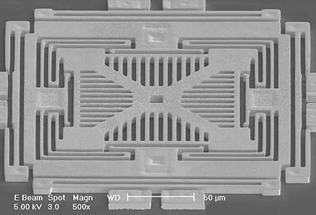
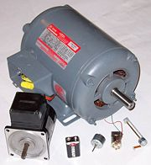
We live in an analog world
Everything in the physical world is an analog signal
Sound, light, temperature, pressure
But the computer world is a digital world
Need to convert physical phenomenon into electrical signals
Transducers: converts one type of energy to another
Electro-mechanical, Photonic, Electrical, …
Examples
Microphone/speaker
Thermocouples
Accelerometers

Slide 5
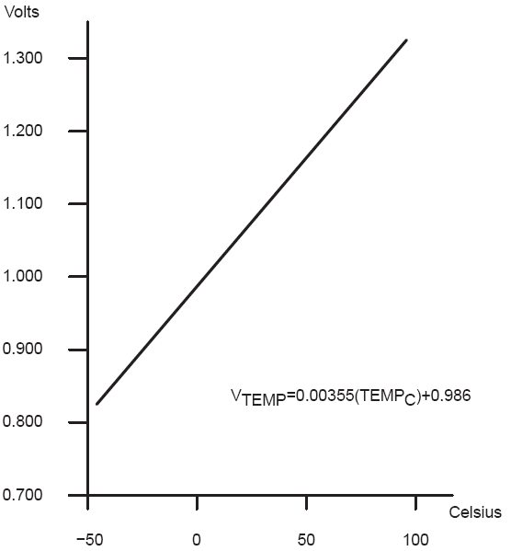
Transducers
Transducers convert one form of energy into another
Allows us to convert physical phenomena to a voltage potential in a well-defined way
A transducer is a device that converts one type of energy to another. The conversion can be to/from
electrical, electro-mechanical, electromagnetic, photonic, photovoltaic, or any other form of energy.
While the term transducer commonly implies use as a sensor/detector, any device which converts energy can be considered a transducer. [Wikipedia]
Converts
temperature to volts

Slide 6
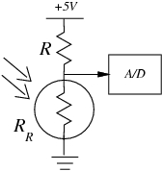
An Example: Photocell
Convert light to voltage using a photocell
A photocell is a resistor that changes resistance depending on the amount of light incident on it.
This variable resistance, results in variable output voltages. This is essentially what a
transducer does; transforming a light input to a voltage output.
The output voltage is calculated as below:
V_{signal} = (+5V) R_{R}/(R + R_{R})

Slide 7
Sensors
A sensor is a device that detects and responds to some type of input from the physical environment. Some types of sensors are;
Force sensors
Sound sensors
Microphones
Position sensors
Gyroscope
Acceleration sensors
Field sensors

Slide 8
Going from Analog to Digital
What we want
But our computer only understands zero and one
How we have to get there
Physical
Phenomena
Engineering Units
Physical
Phenomena
Voltage or
Current
Engineering Units
ADC Counts
Sensor
ADC
Software

Slide 9
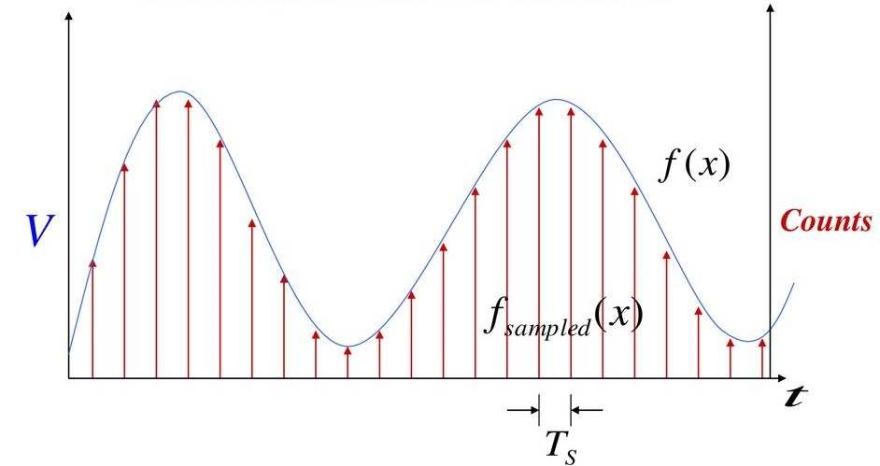
Representing an analog signal digitally
An analog signal has infinite number of continuous values. We have limited computation and storage resources for this amount of data. Thus, we record the analog signal at regular discrete moments of time; this is called sampling.
So we use sampling to represent an analog signal, digitally.

Slide 10
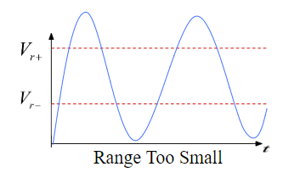
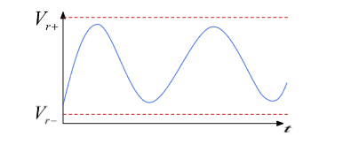
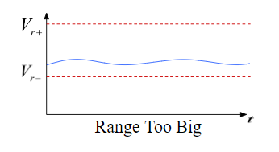
Choosing the horizontal range
What do the sample values represent?
Some fraction within the range of values
What range to use? The ideal voltage range should cover the changes of the physical phenomena whilst not being too far off.
The range should be neither too large nor too small
Ideal Range

Slide 11
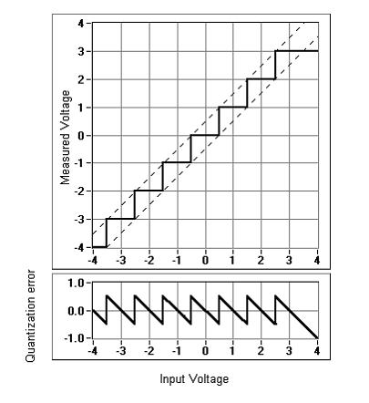
Choosing the horizontal granularity
Resolution
Number of discrete values that represent a range of analog values
12-bit ADC
4096 values
Range / 4096 = Step
Larger range less information

Slide 12
Choosing the horizontal granularity
Quantization Error
How far off discrete value is from actual analog value
½ LSB Range / 8192
Larger range larger error
The more number of bits we have for representing, the more the resolution, the less the quantization error.
more bits smaller error higher resolution

Slide 13
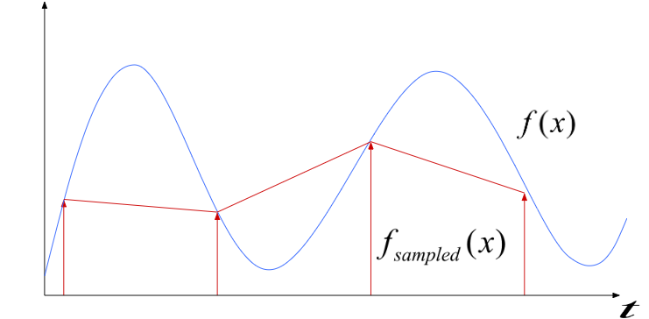
Choosing the sample rate
What sample rate do we need?
Too low: we can’t reconstruct the signal we care about
Too high: waste of computation, energy, resources

Slide 14
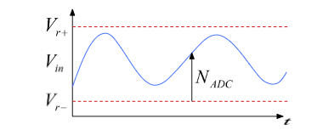
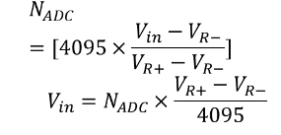
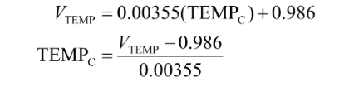
Conversion: ADC
Converting between voltages, ADC counts, and engineering units
Converting: ADC counts Voltage
Quantization error should also be considered
Converting: Voltage ⬄ Engineering Units

Slide 15
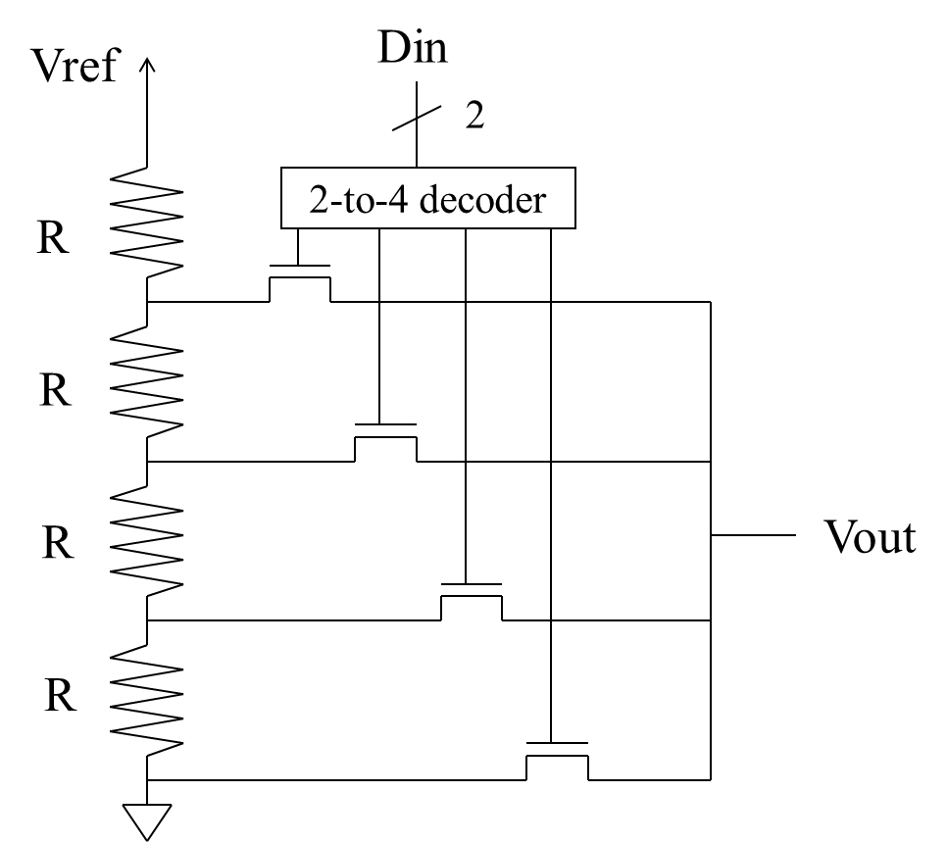
Conversion: DAC
DAC 1: Voltage Divider
The input is 2 bits
The value of output is also limited

Slide 16
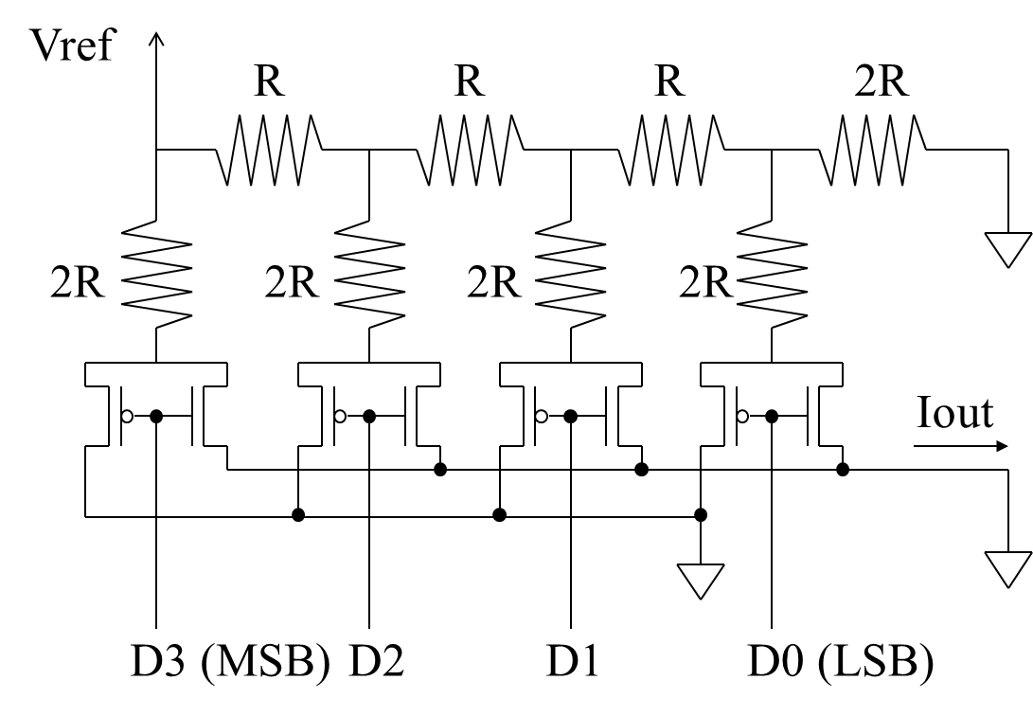
Conversion: DAC
DAC 2: R/2R Ladder
The input is 4 bits

Slide 17
ADC in SAM3X
Only one ADC is used in this microcontroller
Our micro has a 16-to-1 analog multiplexer
Making possible the analog-to-digital conversions of 16 analog lines
The conversions extend from 0V to ADVREF
Supports a 10-bit or 12-bit resolution mode
Conversion results are reported to a common register for all channels
As well as a channel-dedicated register
1 MHz Conversion Rate
Individual Enable and Disable of Each Channel

Slide 18
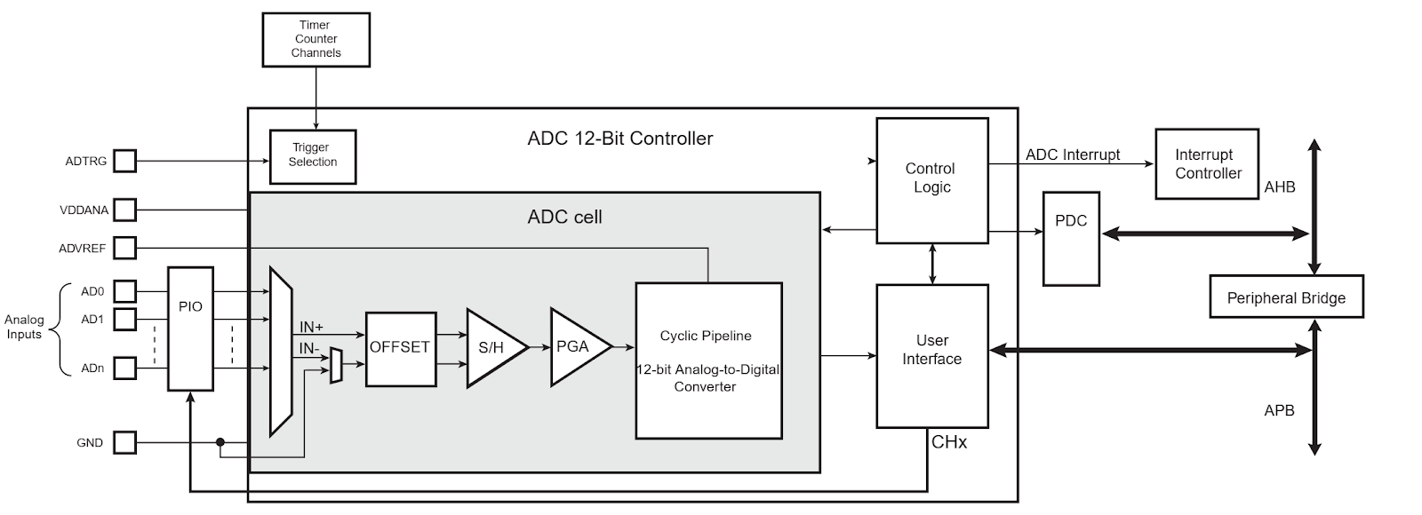
ADC in SAM3X (Block Diagram)
Analog-to-Digital Converter Block Diagram
The temperature sensor is connected to Channel 15 of the ADC

Slide 19
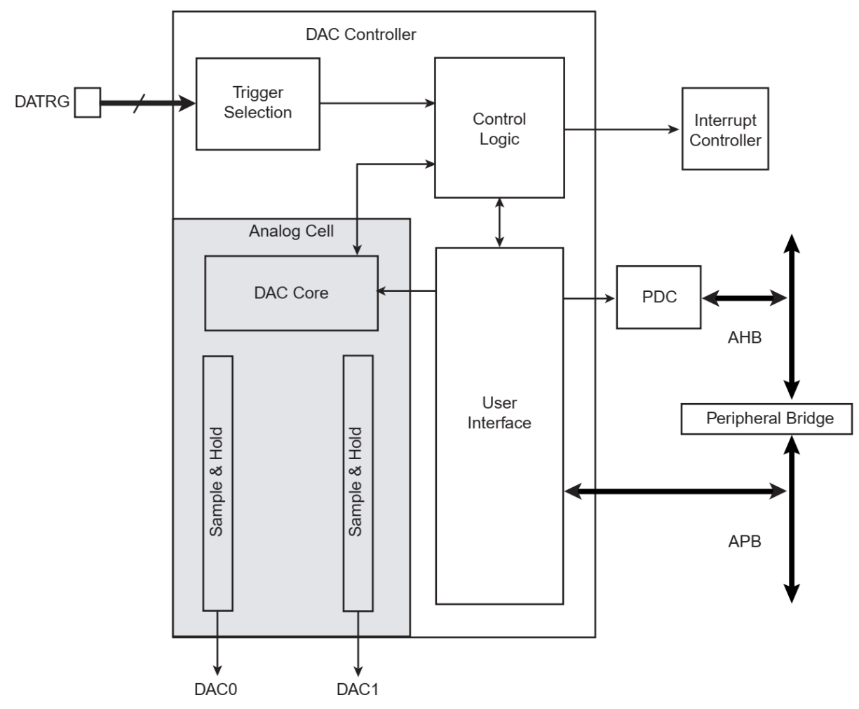
DAC in SAM3X
Digital-to-Analog Converter Controller (DACC)

Slide 20
The End!

